Slide 1
TYPES OF INTERPRETING
Presented by MCA

Slide 2
Types of Interpreting
Consecutive
Simultaneous
Sight
Summarization
Remote

Slide 3
Consecutive
One speaker says a few sentences, the interpreter interprets, the speaker responds, etc. This is the most common mode in medical interpreting.

Slide 4
Simultaneous
The interpreter interprets at the same time that the speaker is speaking, just a few seconds behind. This is more useful for large groups such as the UN meetings.

Slide 5
Summarization
One person speaks at length and the interpreter summarizes the important points at the end of the speech. This is not recommended in a medical setting because of the great potential for errors and omissions

Slide 6
Sight
The interpreter takes a written document and reads it aloud in another language. This is used for consent forms, discharge instructions, etc.

Slide 7
Remote
Video and telephone interpreting. May be working in a call center or from home. Advantages: not see disturbing “visuals” (non-video) as in an emergency room. Prevent bias due to race, dress, speaker’s identity, etc.

Slide 8
Sight interpretation
MEDICAL COMMUNICATION AMBASSADORS

Slide 9
What is sight translation?
Sight translation: oral rendition of text written in one language into another language and is usually don in the moment

Slide 10
Challenges: linguistic
Acronyms
Cognates
Parts of speech sequence
Cultural adaptation: concepts that do not transfer well

Slide 11
Challenges: non-linguistic
Time constraints: flow, pacing
Text written by hand
Ungrammatical sentence structure
Interpreting visual-aided text (graphs, table, pictures or diagrams)
Complicated vital documents: bill of rights, HIPPA, etc

Slide 12
Skills for sight translation
Fast read/comprehension
Anticipate meaning/connect the facts
Unknown words, focus on message of sentence rather than word meaning
Dealing with long sentences/focus on meaning rather than structure

Slide 13
Using your own words
You may use your own words.
You may change the register but not the meaning
Example:
Endoscopic surgery/can also be utilized/for removal/of polyps/nasal masses/and sometimes/ straightening the septum/to improve/nasal airflow
Could be: surgery endoscopic/can also be used/ for the removal/of polyps/masses in the nose/and sometimes/to straighten the septum/to improve/airflow into the nose

Slide 14
recommendations
Documents with specific instructions may be translated in the presence of a provider
Read aloud documents that were translated by a professional such as: hipaa, educational materials
May sight translate “simple” written “brief and non-technical” information on discharge forms or dosage labels

Slide 15
ACTIVITY: read the following:
Keep the injured limb elevated as much as possible to reduce swelling and pain. The higher you can elevate an injured arm or leg above your heart, the less swelling will develop. An ice pack applied for 15 minutes every hour is also very helpful. These two measures are most important in the first 24 to 48 hours and elevation should be continued for as long as there is swelling.

Slide 16
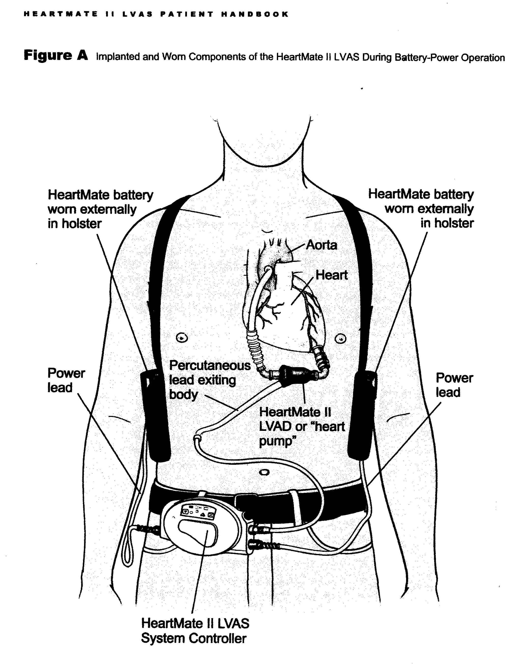

Slide 17


