Slide 1
HAND WASHING/INFECTION CONTROL
Presented by Mca

Slide 2
Types Infection Control
Airborne
Droplet
Contact
Neutropenic/protective
Enteric

Slide 8
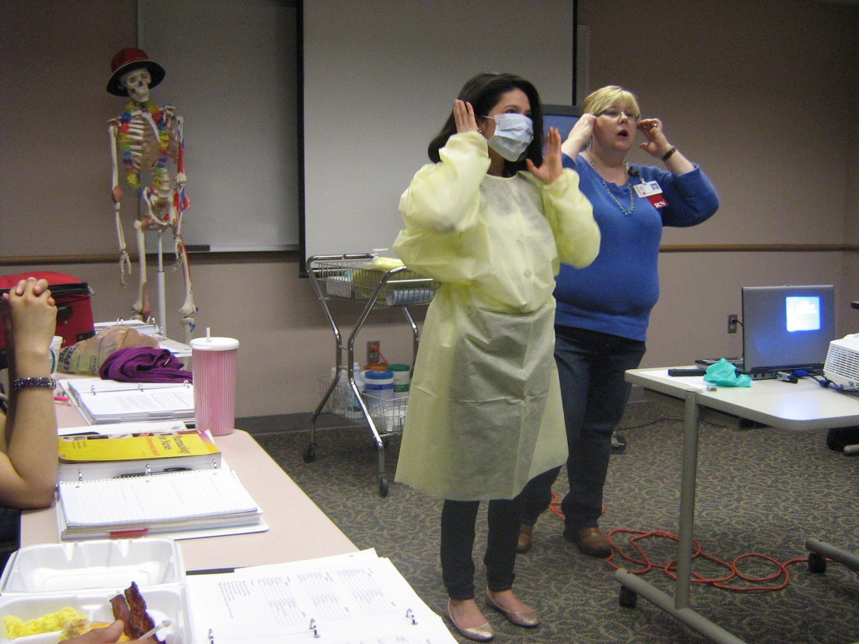

Slide 9
HEALING HANDS START WITH YOU
A simple action…
Hand hygiene is the # 1 intervention proven to be effective in preventing healthcare associated infections and the spread of antimicrobial resistant organisms.
…..and it starts with you

Slide 10
HAND HYGIENE…WHY ALL THE FUSS?
According to the CDC, each year in the U.S., approximately two million hospitalized patients develop healthcare-associated infections (HAI).
Of these two million patients, up to 90,000 die as a result of the HAI.
The estimated annual cost is approximately $6.65 billion in 2007 dollars.
The most common mode of transmission of germs is by your hands.

Slide 11
WHO SHOULD PERFORM HAND HYGIENE?
Any healthcare worker, caregiver or person involved in direct or indirect patient care, needs to be concerned about hand hygiene and should be able to perform it correctly and at the right time.

Slide 12
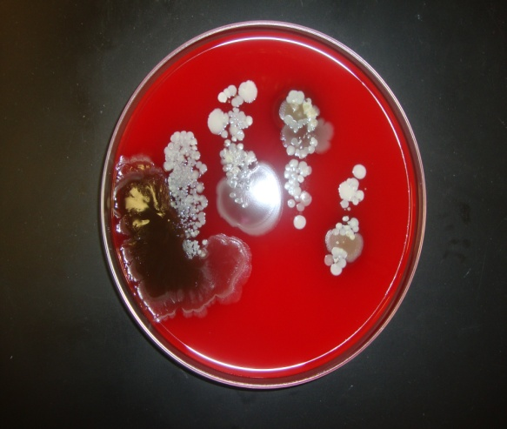
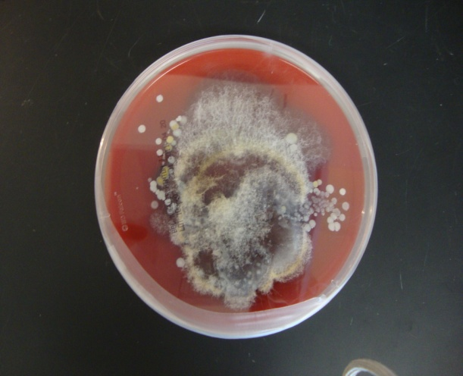
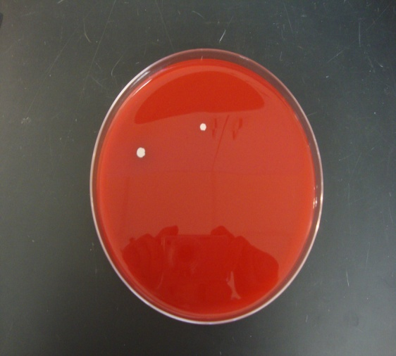
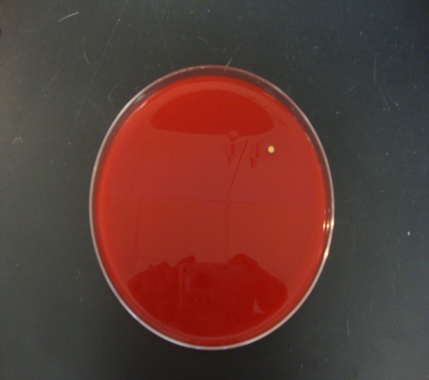
SOMETIME SEEING IS BELIEVING…

Slide 13
GLOVE
Nurse’s glove while caring for an isolation patient

Slide 14
HAND
Hand of an employee while in common work area

Slide 15
WASHING
After washing with soap and water

Slide 16
RUBS
After using alcohol based hand rub

Slide 17
HAND HYGIENE
The purpose of hand hygiene is to kill microorganism that have been picked up by contact with patients, visitors, staff, keyboards, door knobs, telephones, contaminated equipment or the environment.
There are 2 methods for performing hand hygiene, soap and water and alcohol-based hand rubs.

Slide 18
INDICATIONS FOR HAND HYGIENE
Wash your hands with soap and water when:
Visibly dirty or soiled
Before eating
After using the restroom
After coughing, sneezing or blowing your nose
Use an alcohol-based hand-rub as the preferred means for routine hand antisepsis

Slide 19
HOW TO HAND WASH WITH SOAP AND WATER
Critical components for effective hand washing:
Wet hands with water
Apply adequate soap
Scrub all surface for a minimum of 15 seconds
Dry hands thoroughly
Turn off faucet with paper towel to prevent recontamination

Slide 20
UPON ENTERING THE PATIENT ROOM/SPACE, BEFORE TOUCHING THE PATIENT OR THE ENVIRONMENT
WHY? To protect the patient against colonization by harmful germs carried on your hands.
WHEN? Clean your hands before touching a patient when approaching him/her.
Situation when Moment 1 applies:
Before shaking hands, before stroking a child’s forehead for example

Slide 21
AFTER TOUCHING A PATIENT
WHY? To protect you from colonization or infection with patient’s harmful germs and to protect the health-care environment from germ spread.
WHEN? Clean your hands when leaving the patient’s side, after having touched the patient.
Situations when Moments 4 applies, if they correspond to the last contact with the patient before leaving him/her:
After shaking hands.

Slide 22
USE OF GLOVES
The use of gloves does not replace the need for hand hygiene by either soap and water or an alcohol based hand-rub.
Wear gloves when it can be reasonably anticipated that contact with blood or other potentially infectious material, non-intact skin or mucous membranes may occur.
Do not wash or use alcohol hand rub on gloved hands.
Remove gloves after leaving patient room. Do not wear the same pair of gloves if you are interpreting for more than one patient.

Slide 23
