Slide 1
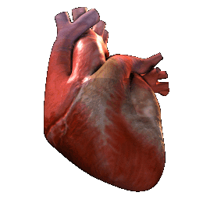
Cardiovascular System
MCA MEDICAL INTERPRETERS COURSE

Slide 2
Cardiology In this chapter you will learn:
Anatomy and physiology of the cardiac system
Cardiac problems and what causes them
Terminology

Slide 3
Medical Prefixes
Erythro-red-Spanish: eritr/eritro
Cardi-heart-Spanish: cardi/cardio
Angi-vessel
Hemo/emia-blood-Spanish: hem/hemat
Vascular-pertains to the vessels
Phlebo/veno- vein-Spanish: fleb, flebo
Arterio-arteries-Spanish: arteri/arter
Brady/tachy- slow/fast-Spanish: bradi
Stasis-to stop-Spanish: stasis
Cyte/o-cell-Spanish: cit/cito

Slide 4
Cardiology
The heart is a cardiac muscle (innervates itself)
The primary function of the heart is to pump blood through the arteries, capillaries, and veins of the body.
The heart transports oxygen and nutrients to the organ of the body.
This system also regulates blood pressure

Slide 5
Blood Pressure
Blood pressure is the force it takes to pump blood through the body
Systolic: The top number refers to the amount of pressure in your arteries during contraction of your heart muscle. This is called systolic pressure (systole)
Diastolic: The bottom number refers to your blood pressure when your heart muscle is between beats. This is called diastolic pressure (diastole)
For example: 120/80 is a good blood pressure. 190/100 is bad, this means that the heart is working overtime.

Slide 6
Blood Pressure Category | Systolic mm Hg (upper #) |  | Diastolic mm Hg (lower #)
Normal | less than 120 | and | less than 80
Prehypertension | 120 – 139 | or | 80 – 89
High Blood Pressure (Hypertension) Stage 1 | 140 – 159 | or | 90 – 99
High Blood Pressure (Hypertension) Stage 2 | 160 or higher | or | 100 or higher
Hypertensive Crisis (Emergency care needed) | Higher than 180 | or | Higher than 110

Slide 7
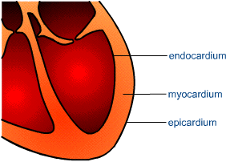
Gross Anatomy of the Heart
The heart wall consists of three layers:
Epicardium/epicardio
Serous membrane on the heart surface
Endocardium/endocardio
Lines the interior of the heart chambers
Myocardium/miocardio
Layer between the epicardium and endocardium

Slide 8
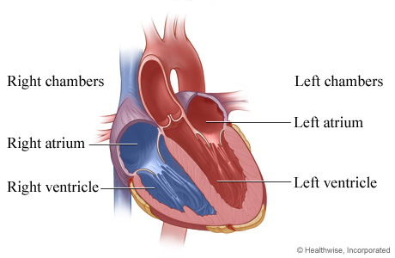
Gross Anatomy of the Heart continued
Chambers
Heart has four chambers
Two at the superior pole of the heart
Right and left atria
Their thin walled receiving chambers for blood returning to the heart by way of the great veins.
Two inferior heart chambers the right and left ventricles
are the pumps that eject blood into the arteries and keep it flowing around the body.

Slide 9
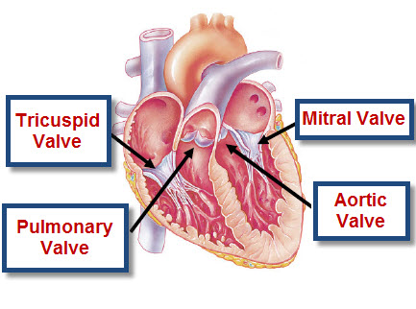
Gross Anatomy of the Heart continued
Valves
There are 4 valves
aortic valve
Pulmonic valve
mitral
tricuspid

Slide 10
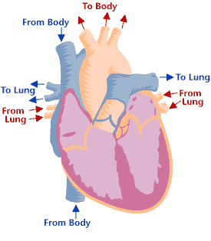
The Pulmonary and Systemic Circuits
The cardiovascular system consists of the heart and the blood vessels that carry the blood to and from the body’s organs. The system consists of two major divisions:
Pulmonary circuit
Systemic circuit

Slide 11
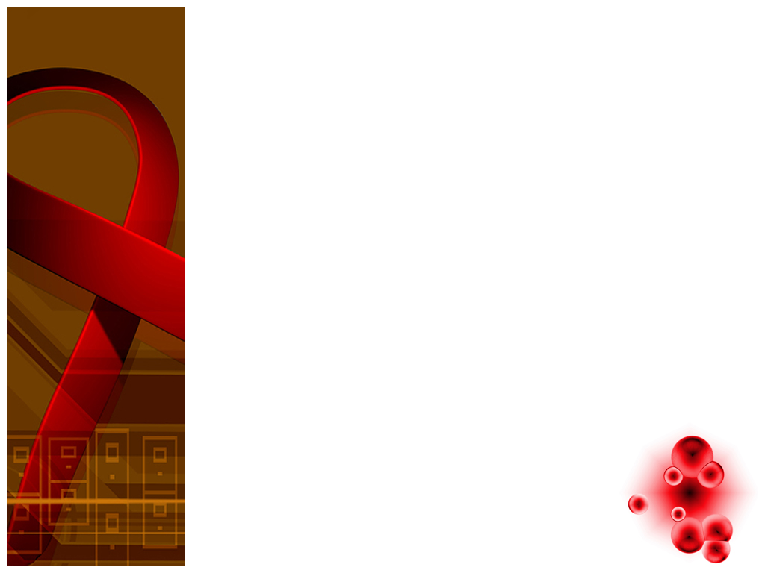
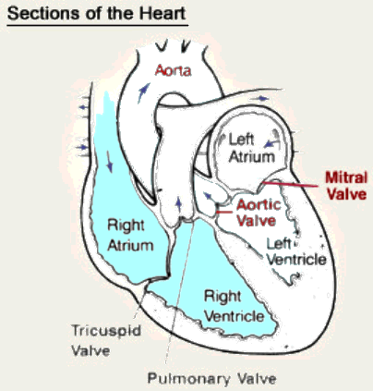
Pulmonary Circuit
Carries blood to lungs for gas exchange and returns it to the heart.
The right side of the heart serves the pulmonary circuit.
It receives blood that has circulated through the body, unloaded its oxygen and nutrients and picked up a load of carbon dioxide and other wastes.
It pumps oxygen poor blood into large artery which immediately divides into right and left pulmonary arteries.

Slide 12
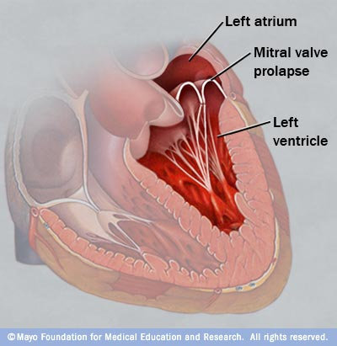
Systemic Circuit
Supplies blood to every organ of the body, including other pars of the lungs and the wall of the heart.
left side serves the systemic circuit.
Blood leaves it by way of another large artery the aorta.
After circulating the through the whole body the deoxygenated blood returns to the right side of the heart mainly by way of the superior vena cava and inferior vena cava.

Slide 13
Problems
Angina
Arteriosclerosis
Coronary artery disease
Myocardial infarction
Pulmonary edema
Hypertension
Arrythmias/dysrhythmia
Heart murmur
Pericarditis

Slide 14
Angina
Angina pectoris (angina pectoris)– Literally, “pain in the chest.” But, this is a special kind of pain associated with the heart and is distinctive as “crushing, vise-like”, and often accompanied by shortness of breath, fatigue and nausea.
Anginal pain indicates not enough blood is getting to the heart muscle, and the heart is protesting and begging for more. People with a history of angina often take nitroglycerine tablets to relieve the pain by increasing blood flow to the heart muscle.

Slide 15
Atherosclerosis
Atherosclerosis (artrosclerosis)– Literally, “hardening of the fatty stuff.” High fat diets can lead to formation of fatty plaques lining blood vessels. These fatty areas can become calcified and hard leading to arteriosclerosis, hardening of the arteries.
When blood vessels become less stretchable, blood pressure rises and can result in heart and kidney damage and strokes.

Slide 16
Mitral Prolapse
Mitral prolapse, stenosis, regurgitation ( (el prolapso de la valvula mitral, estenosis)– Blood flows through four chambers in the heart separated by one-way valves.
A major valve is the one separating the upper and lower chambers on the left side of the heart.
The left valve, called atrioventricular, for the chambers it separates, is also called the mitral valve.
If the flaps of this valve tear away due to disease, the process is called prolapse, “a falling forward.” This results in leakage and backward flow called “regurgitation”.
Sometimes a valve is abnormally narrow causing partial obstruction constricting flow. Stenosis means “a narrowing.”

Slide 17
Arrhythmias/Ischemia
Arrhythmia/dysrhythmia (la arrítmia, la isquemia)– Abnormal heart rates and rhythms all have special names like ventricular tachycardia, fibrillation, but generically are termed arrhythmias or dysrhythmia, meaning “no rhythm” and “abnormal rhythm.” There are fine distinctions between the two, but they are often used interchangeably.
Ischemia– Sometimes the heart muscle is not getting enough blood flow, more importantly, the oxygen the blood carries is insufficient to sustain muscle which has a very high metabolic rate, and oxygen demand. The term loosely means “not quite enough blood.” Typically, the patient suffers angina pain (see above) and they may think they are having a heart attack. And, they may be!

Slide 18
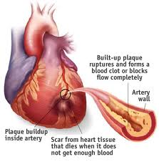
Myocardial Infarction (MI) el infarto cardíaco
Also known as a heart attack
A heart attack occurs when blood flow to a part of your heart is blocked for a long enough time that part of the heart muscle is damaged or dies.
http://www.youtube.com/watch?v=mAqI-P6ig9Q

Slide 19
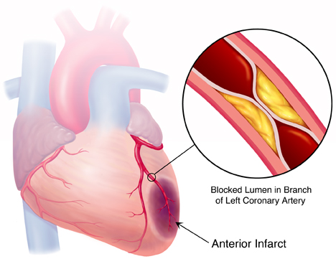
Causes
Most heart attacks are caused by a blood clot that blocks one of the coronary arteries.
The coronary arteries bring blood and oxygen to the heart.
If the blood flow is blocked the heart is starved of oxygen and heart cells die.
The plaque can develop cracks or tears. Blood platelets stick to these tears and form a blood cot.
A heart attack can occur if this blood
clot completely blocks oxygen rich blood
form flowing to the heart. This is the most
common cause of heart attacks.

Slide 20
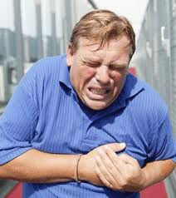
Causes cont.
The cause of heart attack is not always known.
Heart attacks may occur when:
Your are resting or sleeping
After a sudden increase in physical activity
When you are active outside in cold weather
After sudden, severe emotional or physical stress, including an illness.

Slide 21
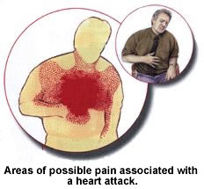
Location of Pain
Severe pain or pain over the pericardium
May spread widely throughout chest and be accompanied by pain in the:
Shoulders
Arms
Jaw
Belly or back
Pain maybe described as
Crushing or squeezing

Slide 22
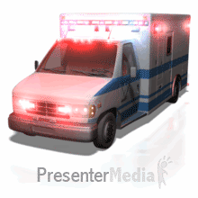
Associated Symptoms
Chest pain is the most common symptom
Feeling impending doom
Fatigue
Nausea and vomiting
Shortness of breath
Dizziness
Palpitations
Anxiety
IF YOU SUSPECT A HEART ATTACK CALL 911 OR YOUR LOCAL EMERGENCY NUMBER RIGHT AWAY

Slide 23
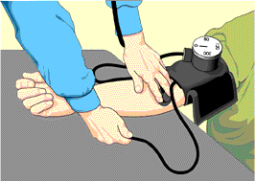
Risk Factors
Age: Men who are 45 or older and women who are 55 or older
Tobacco: Smoking and long-term exposure to secondhand smoke damage the interior walls of arteries.
Diabetes: diabetes greatly increases your risk of a heart attack
High blood pressure: High blood pressure can damage arteries
High blood cholesterol or triglyceride levels: cholesterol builds up deposits that can narrow arteries throughout your body.
Family history
Lack of physical activity
Obesity: with a body mass index
greater than 30
Stress
Illegal drug use

Slide 24
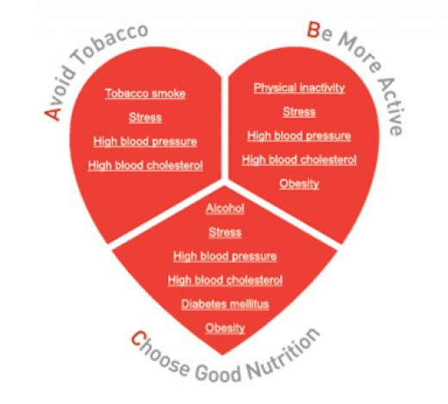
Prevention with lifestyle changes

Slide 25
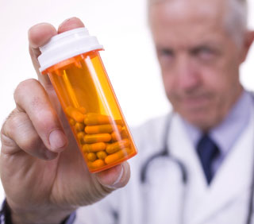
Prevention with Medications
Blood thinning: Aspirin makes blood less sticky and likely clot. Doctors usually recommend a daily aspirin if you are at high risk or have had a heart attack.
Beta blockers: lower heart rate and blood pressure.
Angiotensin-converting enzyme inhibitors: allow blood flow from heart more easily to prevent complications of heart
attacks and make subsequent heart attack less likely.
Cholesterol lowering medications: a variety
of medications including statins, niacin.

Slide 26
Medical Procedures
Angiogram (angiograma)
Cardiac catheterization (cateterización cardiaca)
Echocardiogram (ecocardiograma)
Electrocardiogram (EKG) (electrocardiograma)
Stress test (prueba de la tolerancia al ejercicio)
Coronary artery by-pass with graft (CABG) (desviación aortocoronario con injerto)
Defibrillation (desfibrilación)
Pacemaker (marcapasos)
Notes:
An angiogram is an X-ray test that uses a special dye and camera (fluoroscopy) to take pictures of the blood flow in an artery (such as the aorta) or a vein (such as the vena cava). An angiogram can be used to look at the arteries or veins in the head, arms, legs, chest, back, or belly.

Slide 27
Stress Test (la Prueba de esfuerzo)
An exercise stress test usually involves walking on a treadmill or riding a stationary bike while your heart rhythm, blood pressure and breathing are monitored.
Your doctor may recommend an exercise stress test if he or she suspects you have coronary artery disease or an irregular heart rhythm (arrhythmia).

Slide 28
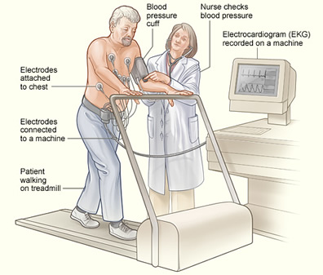

Slide 29
Coronary Artery Bypass Graft (la deviación aortocoronario con injerto)
blocked or narrowed artery, blocked portion of the coronary artery is bypassed with a piece of a healthy blood vessel from elsewhere in your body.
Blood vessels, or grafts, used for the bypass procedure may be pieces of a vein from your leg or an artery in your chest.
An artery from your wrist may also be used. Your doctor attaches one end of the graft above the blockage and the other end below the blockage.
Blood bypasses the blockage by going through the new graft to reach the heart muscle.

Slide 30
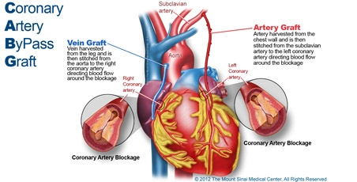

Slide 31
Procedures
Electrocardiogram (ECG/EKG) (electrocardiograma) – a printout recording of the electrical activity of the heart. A frequently used instrument in the hands of a cardiologist.

Slide 32
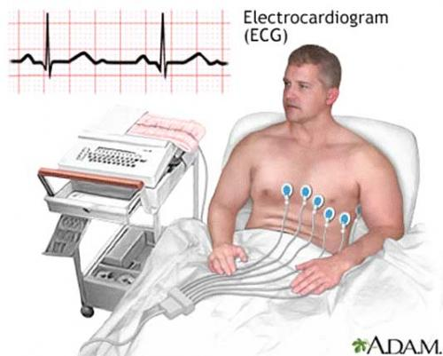

Slide 33
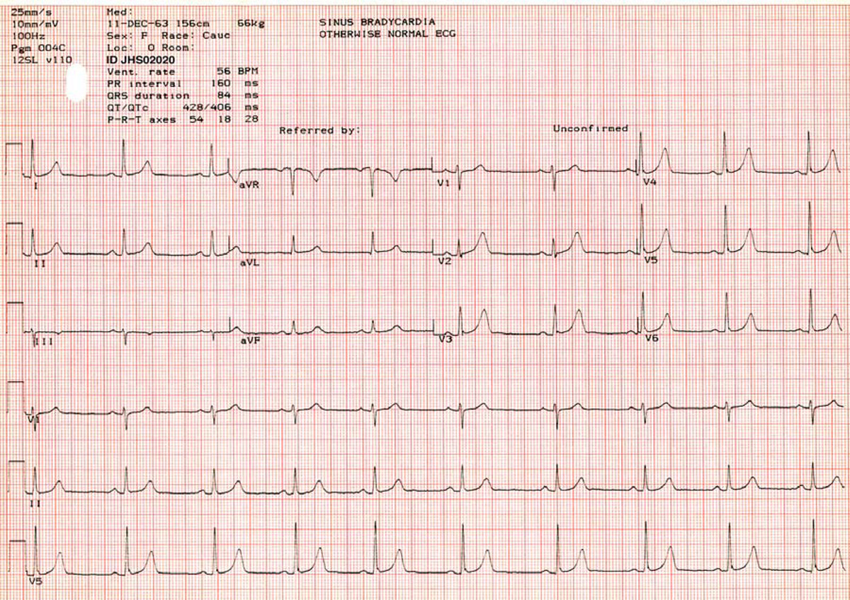

Slide 34
Echocardiography (ecocardiograma)
Echocardiogram – using ultra high frequency sound waves (beyond human hearing), similar to “sonar,” to form an image of the inside of the heart.
This procedure can demonstrate valve damage, congenital (before birth) defects and other abnormalities.

Slide 35
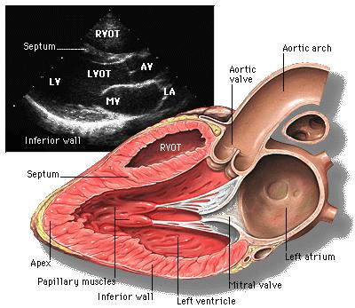

Slide 36
Cardiac Catheterization (El cateterismo cardíaco)
Cardiac catheterization – a long hollow tube, a catheter, can be threaded into an artery up into the heart. Then material opaque to X-rays can be released into the blood flow through the heart imaging the details of coronary arteries.
Typically used to identify a blockage and location in the coronary circulation.

Slide 37
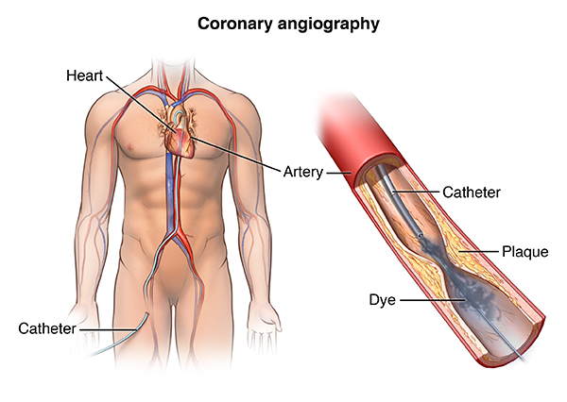

Slide 38
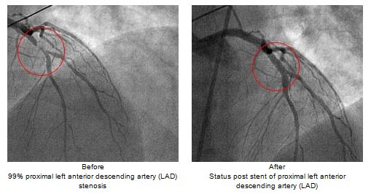

Slide 39
Defibrillation (Desfibrilación)
Defibrillation is a common treatment for life-threatening cardiac dysrhythmias, such as ventricular fibrillation.
Defibrillation is a process in which an electrical device called a defibrillator sends an electric shock to the heart to stop an arrhythmia resulting in the return of a productive heart rhythm.

Slide 40


Slide 41
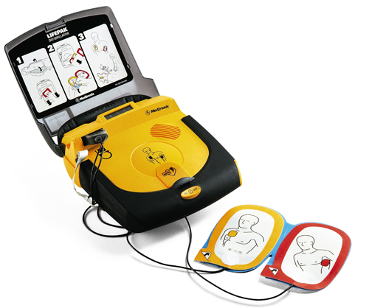

Slide 42
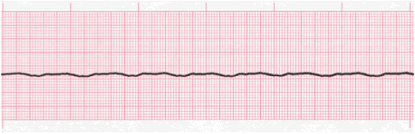

Slide 43
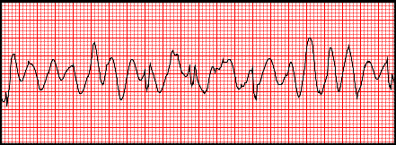

Slide 44
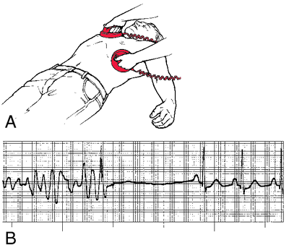

Slide 45
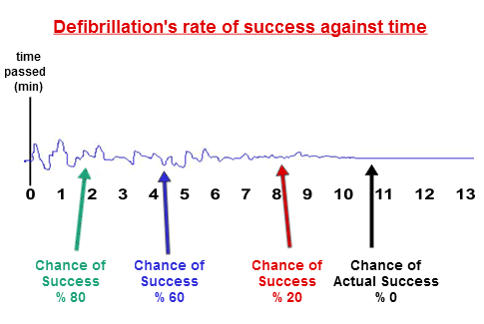

Slide 46
Pacemaker (El marcapasos)
Heart pacemaker definition. A group of specialized muscle fibers in the heart that send out impulses to regulate the heartbeat. If the heart's built-in pacemaker does not function properly, an artificial pacemaker may be necessary.
A pacemaker is a small device that's placed in the chest or abdomen to help control abnormal heart rhythms. This device uses electrical pulses to prompt the heart to beat at a normal rate. Pacemakers are used to treat arrhythmias (ah-RITH-me-ahs). Arrhythmias are problems with the rate or rhythm of the heartbeat.

Slide 47
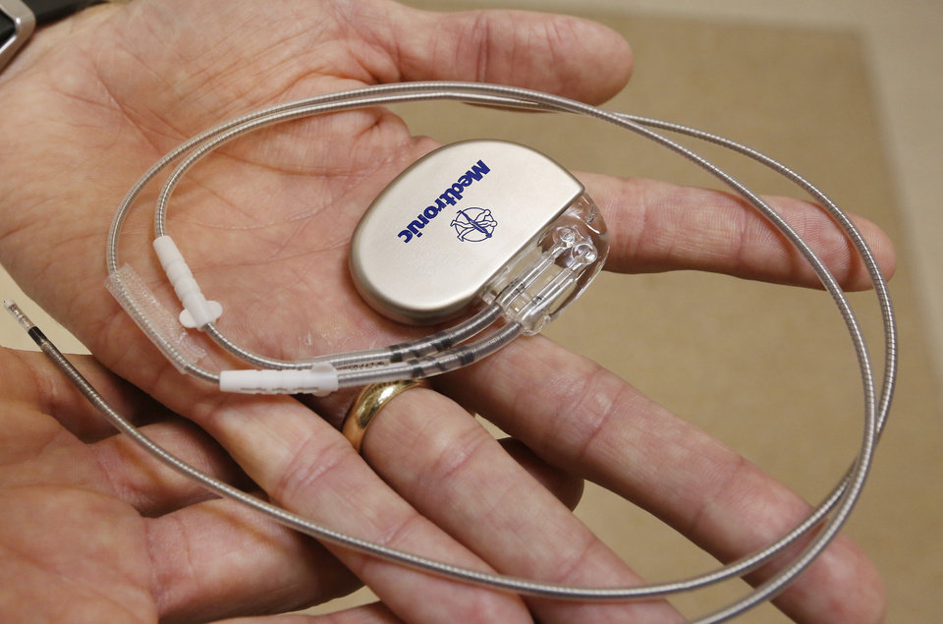

Slide 48
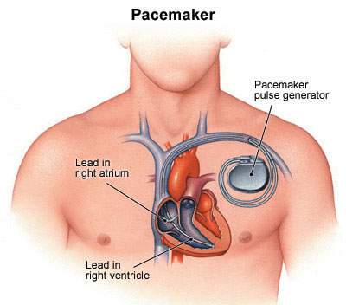
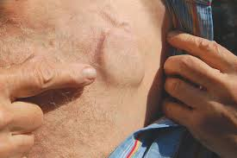

Slide 49
Left Ventricular Assistive Device
The left ventricular assist device, LVAD or VAD, is a kind of mechanical heart pump. It's placed inside a person's chest, where it helps the heart pump oxygen-rich blood throughout the body.
The LVAD doesn't replace the heart. It just helps it do its job. This can mean the difference between life and death for a person whose heart needs a rest after open-heart surgery or is too weak to effectively pump on its own or who is waiting for a heart transplant.
A permanent LVAD is currently being used in some terminally ill patients whose condition makes them ineligible for heart transplantation. This is also called destination therapy.

Slide 50
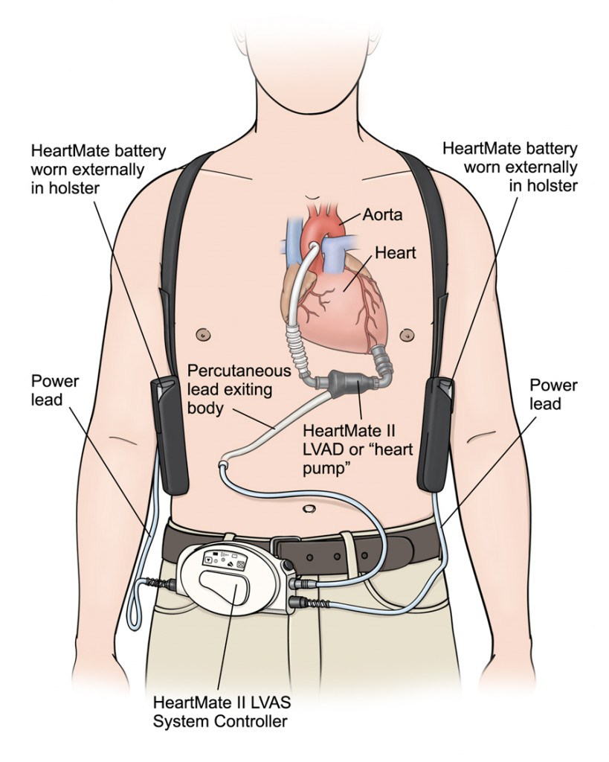
LVAD

Slide 51
Specialties
Cardiologist (el cardiologo) – a physician specializing in the diagnosis and treatment of diseases of the circulatory system, especially, the heart. A cardiologist does not do surgery.
Hematologist (el hematologo) – a physician specializing in diseases of the blood
Cardiovascular surgeon (el cirujano cardiovascular)-performs surgery on the cardiac system
Electrophysiologist (el electrofisiologo) a physician that specializes in pacemakers and the electrophysiology of the cardiac system

Slide 52
Acronyms
CABG: coronary artery bypass graft
EKG: electrocardiogram
PE: pulmonary edema or pulmonary embolism
CHF: congestive heart failure
MI: myocardial infarction
PVD: peripheral vascular disease
DVT: deep vein thrombosis
LVAD: left ventricular assistive device

Slide 53
Fun facts
The heart pumps 5 to7 quarts of blood a day
Some arteries are as wide as your thumb
Athletes pulse can be as low as 35 beats per minute because their hearts are stronger
If you run a mile you can burn 100 calories, you would burn the same 100 calories if you walked the same mile

Slide 54


