Slide 1
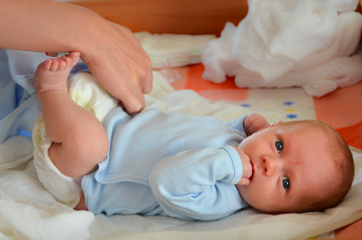
Elimination
Wet Diaper
Birth-1st day: 1-2 wet diapers
Day 2: 2 wet diapers
Day 3: 3 wet diapers
Day 4: 6 wet diapers
Stools
By day 4, a breastfed baby will have 3-4 loose, yellow, seedy stools per day. They may even have a stool with every feeding.

Slide 2
Mother’s Care

Slide 3
Body Changes: Uterus and Blood Flow
Blood flow lasts for 2-4 weeks
Blood will lighten in color and amount
Blood flow can increase with too much activity
Listen to your body and rest.
***Call physician if you
Saturate pad in one hour
Notice a foul smell of discharge
Pass a golf ball-sized clot

Slide 4
Peri Care
Keep area clean to prevent infection
Shower and wash perineum daily, with mild soap
Continue using peri bottle with warm water until you are no longer bleeding
Change pad with each bathroom visit
Use tucks and spray as needed
Tucks work best if refrigerated

Slide 5
Breast Care
Nursing Moms
Tenderness resolves itself in 7-10 days
Use lanolin cream or breast milk for sore nipples.
Engorgement
Warm shower
Massage or use breast pump to soften breast before feeding
Supportive bra
Icepack for discomfort
***Please call the Lactation Center if your breast or nipple pain does not improve

Slide 6
Care After C-Section: Activity
Rest frequently
Do not lift anything heavier than your baby
No vigorous exercise until after 6 week appointment
Get help for housework
Limit stair use—rest between steps if needed
Don’t drive for 2 weeks, or until after you have checked with your physician
***Call physician if you get severe leg cramps or red streaks up the back of your legs

Slide 7
Incision Care
Keep incision clean and dry to prevent infections
Showers only
No tub baths
***Call physician if
There is redness, swelling, or drainage at the incision and it is tender to touch
If you have a fever over 100.4 degrees F
If you have burning and frequency with urination

Slide 8
Pain and Discomfort
Use medications as prescribed by physician if needed
Prevent constipation
Drink 6-8 glasses of water per day
Eat foods that are high in fiber
***Call physician if constipation persists

Slide 9
Pain and Discomfort: Swelling
Swelling is common if you had a C-section or epidural
Drink water
Prop feet up when sitting
Swelling should go down in 2 weeks
***Call physician if
You are short of breath
You have pain in your leg

Slide 10
Nutrition
Healthy calories are needed to rebuild tissue
Fresh fruits
Leafy green vegetables
Whole grains
Healthy fats
Additional “healthy” 300-500 calories needed for breastfeeding
Continue your prenatal vitamins
Drink 6-8 glasses of water per day

Slide 11
Emotional Changes
Hormonal Changes can cause an emotional rollercoaster.
You can be very happy to very sad in a matter of moments
“Baby Blues” usually disappear in 2 weeks

Slide 12
Postpartum Depression
One in 7 moms experiences Postpartum Depression.
PPD is treatable.
*** Call physician if
“Baby Blues” last longer than 2 weeks
You have more severe symptoms

Slide 13
Signs and Symptoms of Postpartum Depression
Persistent feelings of helplessness
Frightening feelings or thoughts
Lack of feelings for the baby
Being overly concerned for the baby
An inability to concentrate
Dramatic changes in sleep patterns
Anger/anxiety
Exaggerated highs and lows
Feelings of inadequacy and inability to cope
Loss of organization and/or decision-making skills
Feelings that run from sadness to thoughts of suicide
You just don’t feel like yourself
***If a loved one suggests you call a doctor, **CALL**

Slide 14
First Night at Home
Get prescriptions filled
Call to schedule your 5-6 week postpartum visit
Get rest at hospital
Don’t plan for a lot of activity
You may get little sleep the first night
Things may not go as planned
Be flexible

